Slide 1
UI / UX בניית ממשק משתמש המספק חווית משתמש
מצגת של @ביל אוגדן
https://web.nmsu.edu/~ogden/cs485/

Slide 2
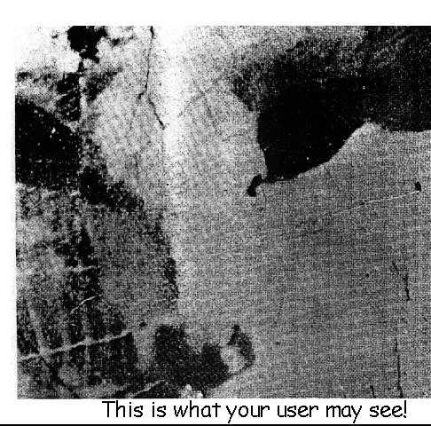
מה שהמשתמש רואה

Slide 3
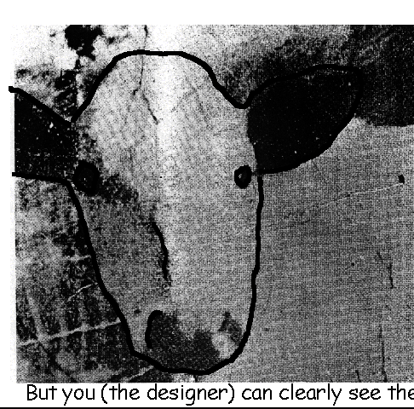
מה אתה בתור המעצב רואה

Slide 4
למה המשתמש לא רואה את הפרה?

Slide 5
What is a good interface?
There is no such thing (tradeoffs in design)
cf. Good furniture arrangement
The test of quality depends on it’s context
How will the software be used? Who will use it? How long?
How important is: Learnability? Portability? ...
The answers vary for each application
Finding the answers is the first step in UI design

Slide 6
What is the user interface?
The User Interface consists of all aspects of the design object that the user interacts with physically, perceptually, or conceptually.
Controls
Labels and signs
Displays
Help and documentation
Etc.
The User Interface is the “bridge” between the Designer and the User.

Slide 7
What to design
Need to take into account:
Who the users are
experience
What activities are being carried out
Task and goals
Where the interaction is taking place
context
Need to optimize the interactions users have with a product
So that they match the users’ activities and needs
Usability / Habitability concerns us the most

Slide 8
Understanding users’ needs
Need to take into account what people are good and bad at
Consider what might help people in the way they currently do things
Think through what might provide quality user experiences
Listen to what people want and get them involved
Use tried and tested user-centered methods

Slide 9
Goals of UI design
Develop usable products
Usability means easy to learn, effective to use and provide an enjoyable experience
Involve users in the design process

Slide 10
Which kind of design?
Number of other terms used emphasizing what is being designed, e.g.,
user interface design, software design, user-centered design, product design, web design, experience design user experience(UX)
Interaction design is sometimes used as the umbrella term covering all of these aspects
fundamental to all disciplines, fields, and approaches concerned with researching and designing computer-based systems for people

Slide 11
HCI and interaction design

Slide 12
Working in multidisciplinary teams
Many people from different backgrounds involved
Different perspectives and ways of seeing and talking about things
Benefits
more ideas and designs generated
Disadvantages
difficult to communicate and progress forward the designs being create

Slide 13
What do professionals do in the ID business?
interaction designers - people involved in the design of all the interactive aspects of a product
usability engineers - people who focus on evaluating products, using usability methods and principles
web designers - people who develop and create the visual design of websites, such as layouts
information architects - people who come up with ideas of how to plan and structure interactive products
user experience designers (UX) - people who do all the above but who may also carry out field studies to inform the design of products

Slide 14
The User Experience
How a product behaves and is used by people in the real world
the way people feel about it and their pleasure and satisfaction when using it, looking at it, holding it, and opening or closing it
“every product that is used by someone has a user experience: newspapers, ketchup bottles, reclining armchairs, cardigan sweaters.” (Garrett, 2003)

Slide 15
Why was the iPod user experience such a success?

Slide 16
What is involved in the process of interaction design
Identifying needs and establishing requirements for the user experience
Developing alternative designs to meet these
Building interactive prototypes that can be communicated and assessed
Evaluating what is being built throughout the process and the user experience it offers

Slide 17
Core characteristics of interaction design
Users should be involved through the development of the project
Specific usability and user experience goals need to be identified, clearly documented and agreed at the beginning of the project
Iteration is needed through the core activities

Slide 18
Why go to this length?
Help designers:
understand how to design interactive products that fit with what people want, need and may desire
appreciate that one size does not fit all
e.g., teenagers are very different to grown-ups
identify any incorrect assumptions they may have about particular user groups
e.g., not all old people want or need big fonts
be aware of both people’s sensitivities and their capabilities

Slide 19
The 3 Q's for Great Experience Design
Factor #1: Understanding the purpose of vision "Does everyone on your team know what the experience will be like interacting with your offerings five years from now?"
Factor #2: Having a solid feedback mechanism "In the last six weeks, have your team members spent at least two hours watching people experience your product or service?“
Factor #3: Living a culture that relishes "failure“ "In the last six weeks, has your senior management held a celebration of a recently introduced design problem?“
By Jared Spool - User Interface Engineering: a leading research, training, and consulting firm specializing in web site and product usability.
http://www.uie.com/articles/the3qs/

Slide 20
Understanding the purpose of vision
When the answer is affirmative, any team member can describe what the user's experience will be like in five years. They'll tell us a story, like this real one from a century-old insurance company:
"An insured home and car owner, having just had a tree fall on their garage, will log into the site, explain the damage, upload pictures, and get initial claim approval to start temporary repairs and get a rental car—all within a few minutes. Within the next 24 hours, inspection appointments and a detailed damage assessment are scheduled and reviewed, and the repairs are underway within 48 hours. All the payments are handled electronically from the insurance company, with a single NET-60 bill sent to the policy holder for the deductibles.“
http://www.uie.com/articles/the3qs/

Slide 21
Vocabulary of Design
Visibility
how easily a user can see what can be done and how to do it
Mappings
how a control and object are related
suffers when more functions than controls
Feedback
shows what has been done
suffers when delayed or not meaningful
Cues and affordances
learned expectations about visual forms

Slide 22
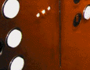
Visibility
• This is a control panel for an elevator.
• How does it work?
• Push a button for the floor you want?
• Nothing happens. Push any other button? Still nothing. What do you need to do?
It is not visible as to what to do!
From: www.baddesigns.com

Slide 23
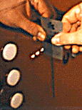
Visibility
…you need to insert your room card in the slot by the buttons to get the elevator to work!
How would you make this action more visible?
• make the card reader more obvious
• provide an auditory message, that says what to do (which language?)
• provide a big label next to the card reader that flashes when someone enters
• make relevant parts visible
• make what has to be done obvious

Slide 24
Vocabulary of Design
Visibility
how easily a user can see what can be done and how to do it
Mappings
how a control and object are related
suffers when more functions than controls
Feedback
shows what has been done
suffers when delayed or not meaningful
Cues and affordances
learned expectations about visual forms

Slide 25
Mapping
Relationship between controls and their movements and the results in the world
Why is this a poor mapping of control buttons?

Slide 26
Mapping
Why is this a better mapping?
The control buttons are mapped better onto the sequence of actions of fast rewind, rewind, play and fast forward

Slide 27
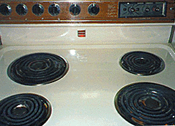
Activity on mappings
Which controls go with which rings (burners)?
A
B
C
D

Slide 28

Why is this a better design?

Slide 29
Vocabulary of Design
Visibility
how easily a user can see what can be done and how to do it
Mappings
how a control and object are related
suffers when more functions than controls
Feedback
shows what has been done
suffers when delayed or not meaningful
Cues and affordances
learned expectations about visual forms

Slide 30
Feedback
Sending information back to the user about what has been done
Includes sound, highlighting, animation and combinations of these
e.g. when screen button clicked on provides sound or red highlight feedback:
“ccclichhk”

Slide 31
Vocabulary of Design
Visibility
how easily a user can see what can be done and how to do it
Mappings
how a control and object are related
suffers when more functions than controls
Feedback
shows what has been done
suffers when delayed or not meaningful
Cues and affordances
learned expectations about visual forms

Slide 32
Affordances: to give a clue
Refers to an attribute of an object that allows people to know how to use it
e.g. a mouse button invites pushing, a door handle affords pulling
Norman (1988) used the term to discuss the design of everyday objects
Since has been much popularised in interaction design to discuss how to design interface objects
e.g. scrollbars to afford moving up and down, icons to afford clicking on

Slide 33
Affordances
When you first see something you have never seen before, how do you know what to do? The answer, I decided, was that the required information was in the world: the appearance of the device could provide the critical clues required for its proper operation.
Affordance, Conventions and Design
By Donald Norman
http://www.jnd.org/dn.mss/affordances-interactions.html

Slide 34
What does ‘affordance’ have to offer interaction design?
Interfaces are virtual and do not have affordances like physical objects
Norman argues it does not make sense to talk about interfaces in terms of ‘real’ affordances
Instead interfaces are better conceptualised as ‘perceived’ affordances
Learned conventions of arbitrary mappings between action and effect at the interface
Some mappings are better than others

Slide 35

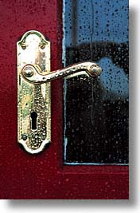

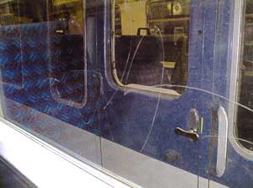
Physical affordances
How do the following physical objects afford? Are they obvious?

Slide 36

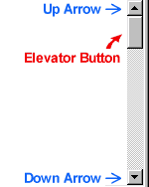

Virtual affordances
How do the following screen objects afford?
What if you were a novice user?
Would you know what to do with them?

Slide 37
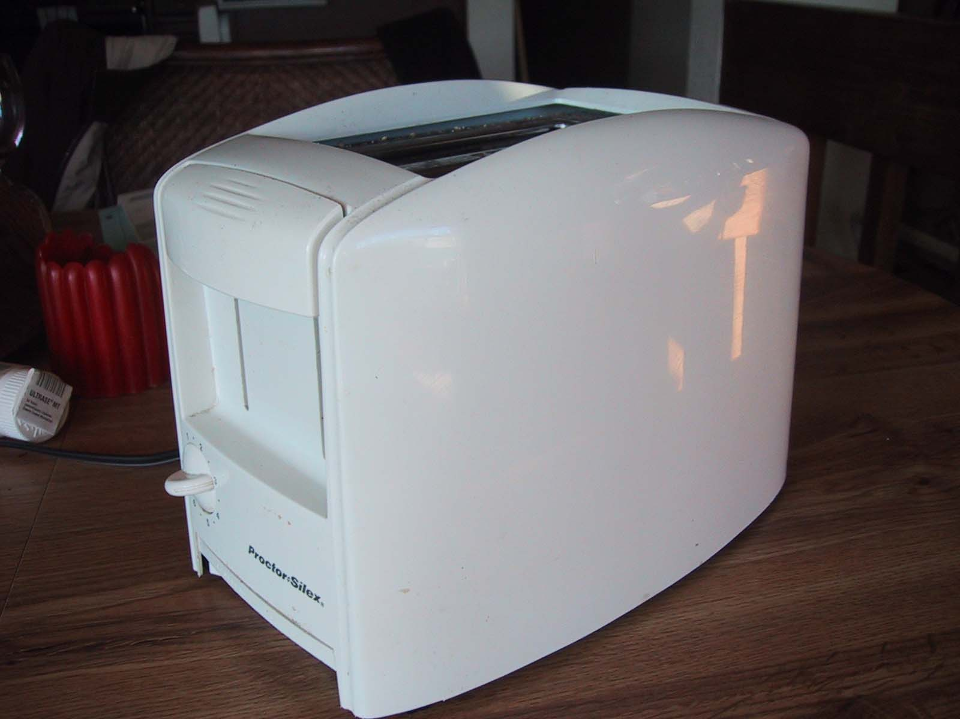

Slide 38
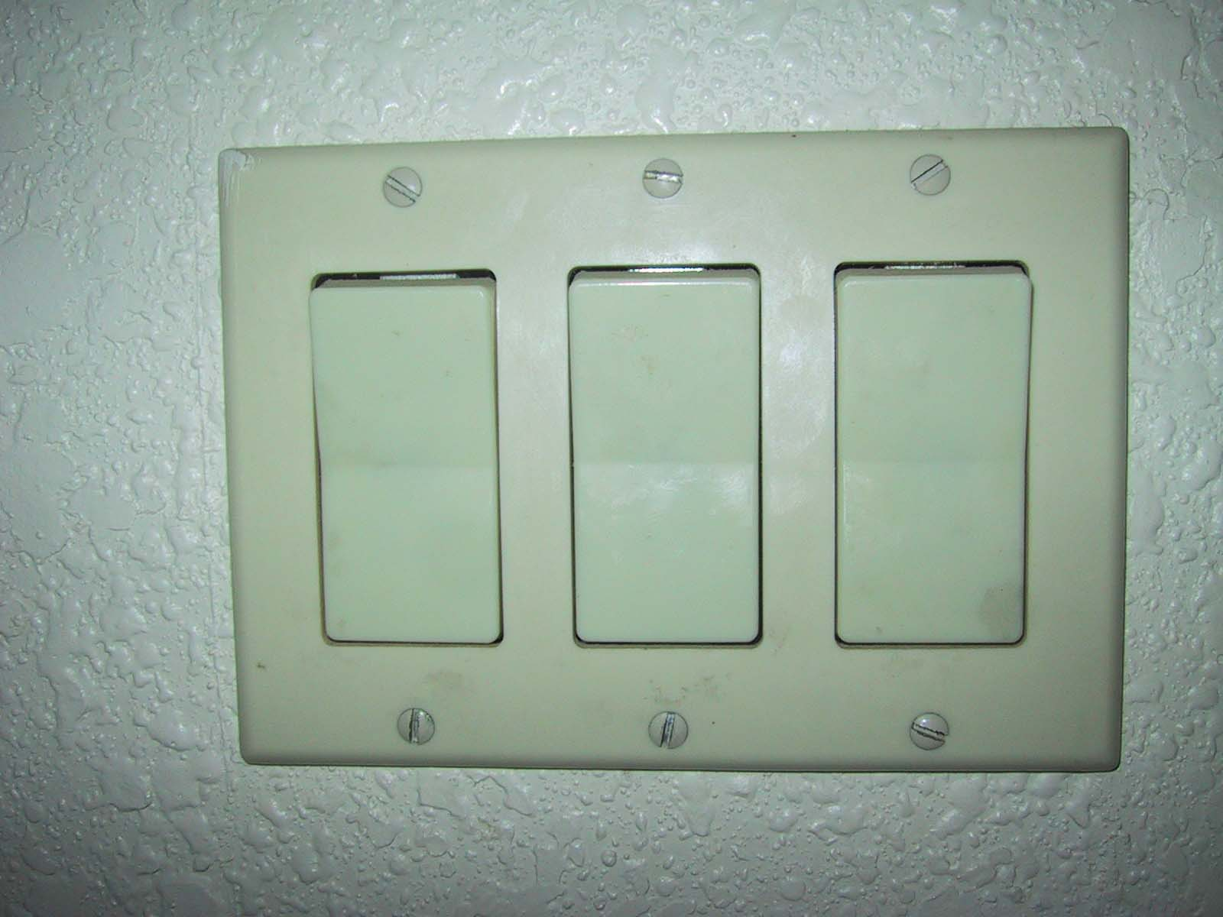

Slide 39
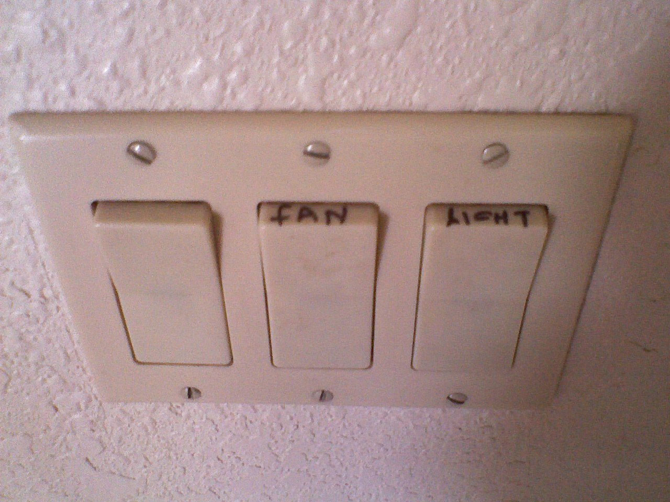

Slide 40
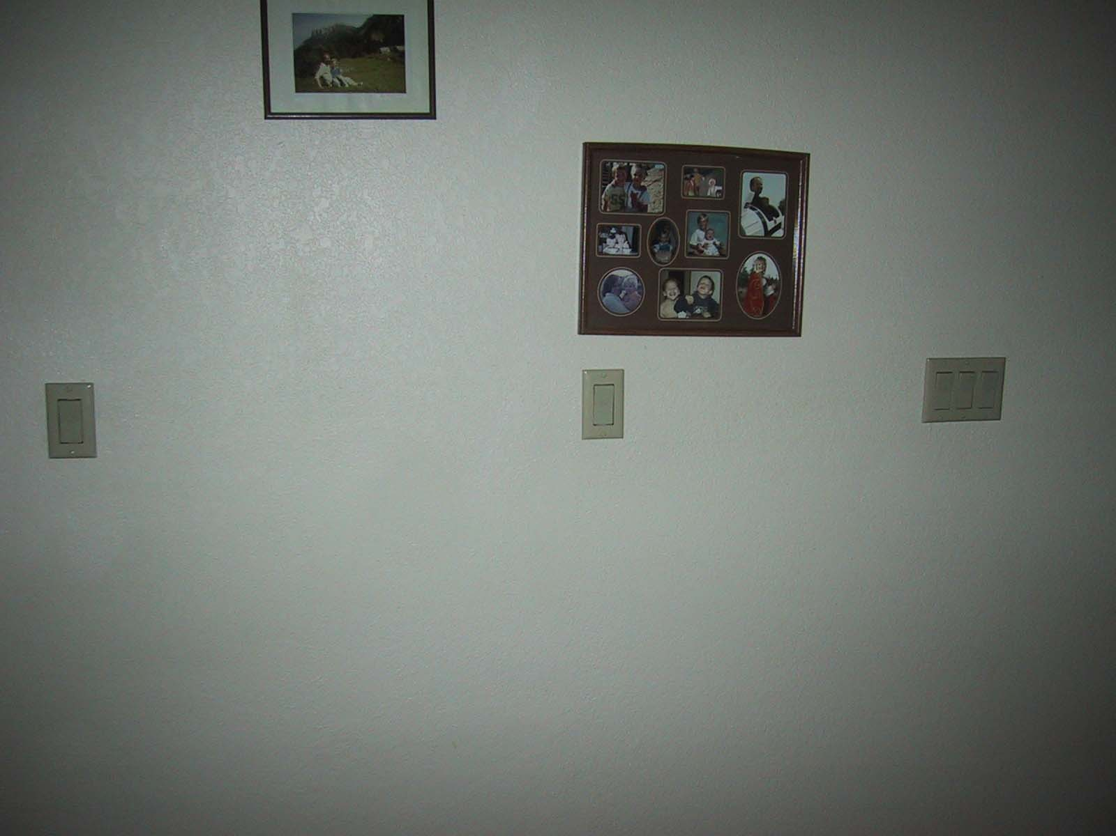

Slide 41
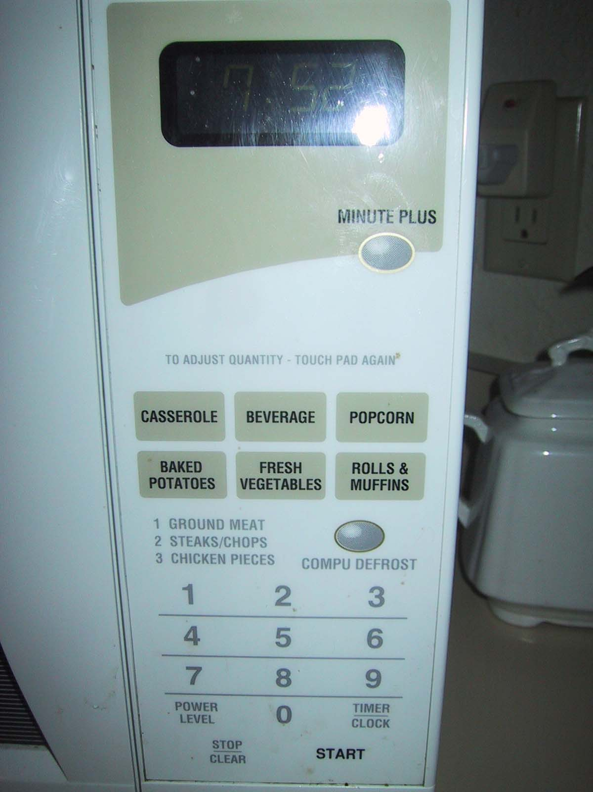

Slide 42
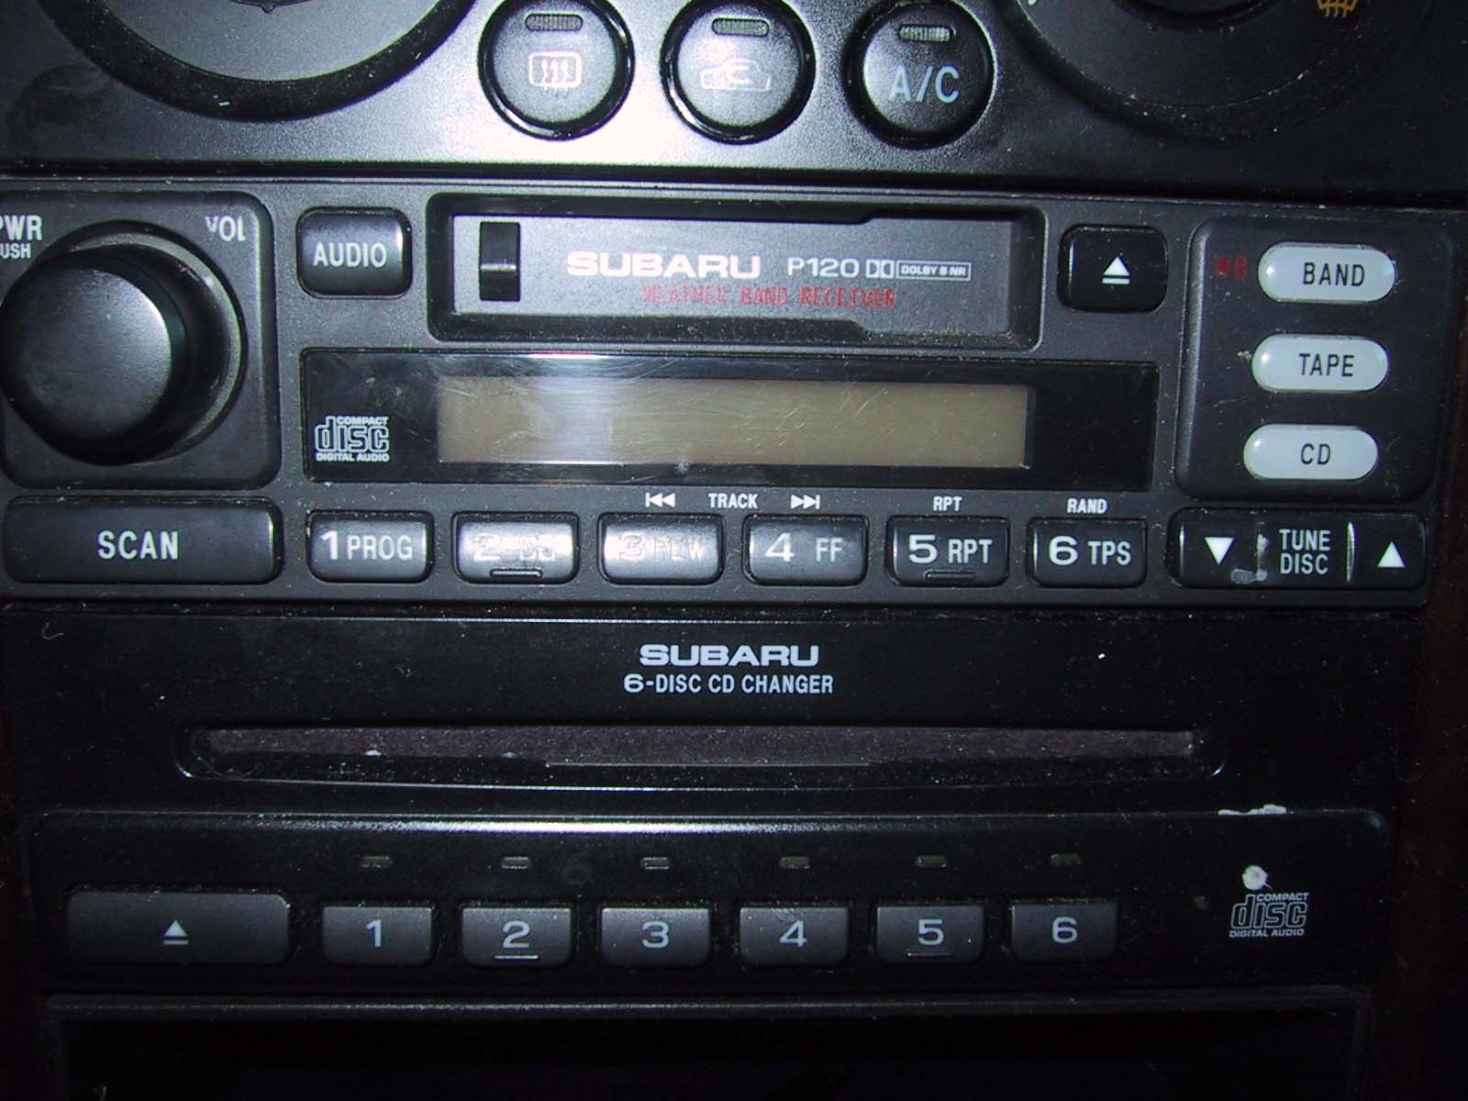

Slide 43
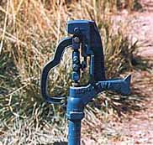
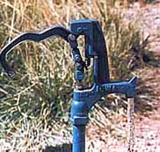

Slide 44
